Slide 1
Image Segmentation of a MICRO-CT Zebrafish Image
Niranjan
Masters Paper Presentation
EE 594 Research

Slide 2
Abstract
Given a set of zebrafish images , to segment out the different tissues inside the zebrafish.
We will experiment with supervised as well as unsupervised approaches.
Find a way to improve the accuracy of segmentation for these images.

Slide 3
Introduction
Genomics Research going on at Hershey Medical Center under Dr Keith Cheng
Inject specific proteins inside the zebrafish. Take a Micro-CT image of the zebrafish
Calculate the statistics such as volume , number of nuclei of specific tissues
Infer about the effects of the protein on different cell tissues.

Slide 4
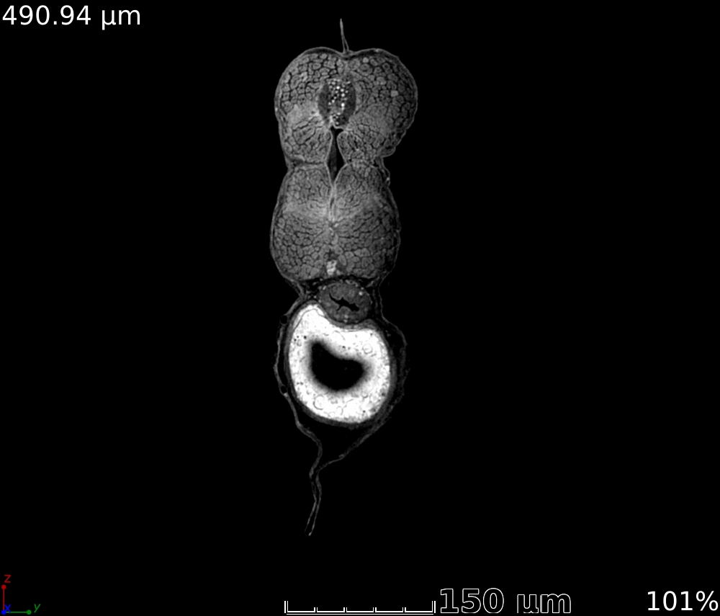
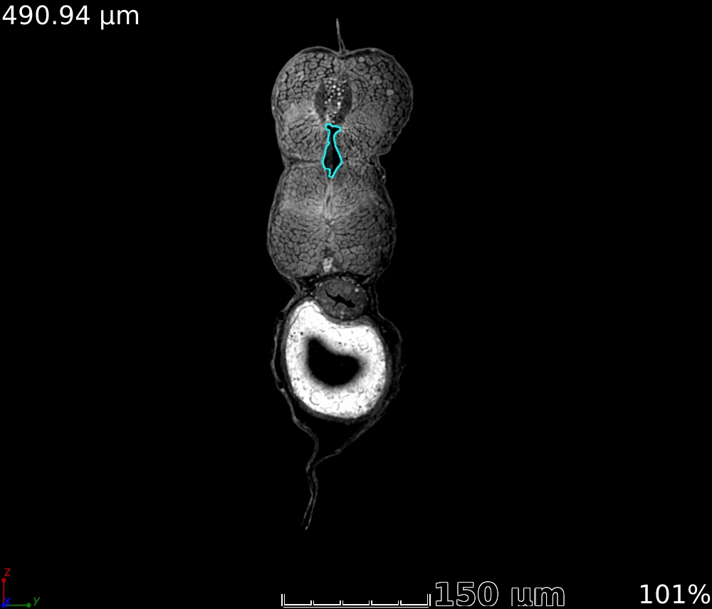
Original Image
Labelled Image – Notochord Tissue

Slide 5
Problem Statement
Given a set of original images, labelled images.
Classify each pixel in the original images whether it belongs to:
Notochord region
Background region

Slide 6
System Description
Data Collection – Dr Keith Cheng , Hershey Medical Center.
Preprocessing. (Cleaning , Creating bounding box for region of interest)
Feature Extraction – Simple Grayscale Values(raw features)
Pixel Classification
Performance Measurements

Slide 7
Data
There are 3 datasets each consisting of which involve cutting the 3-d image along different axis • Coronal view - 854 images
• Sagittal View - 999 images
• Axial View - 1949 images
We will be using ‘axial view’ for notochord and ‘coronal view’ for spinal cord tissue segmentation

Slide 8
Algorithm
Start
Divide dataset into 3 parts- training ,test ,validation
Process images to remove redundant information
Experiment with different window sizes
Experiment with different classifier parameters
Classify each pixel in the test image
Support Vector Machines(SVM)
Markov Random Fields(MRF)+ Gaussian Model
MRF + SVM
Extract features for each pixel and train the classifier
MRF+SVM+GM

Slide 9
FEATURE EXTRACTION
Raw features( grayscale values) are used for a specific window size
Window size is varied for extracting different length features

Slide 10
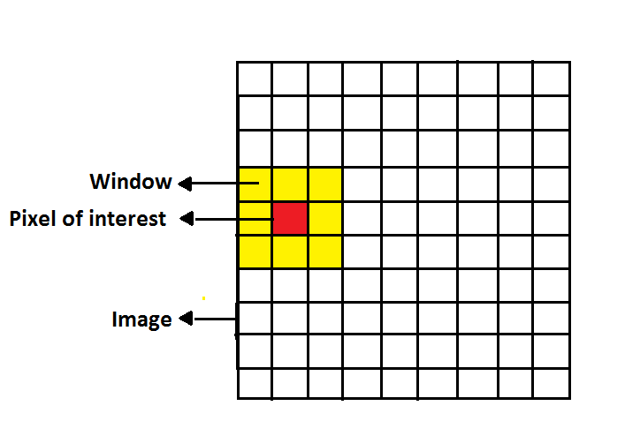
Raw grayscale values extraction

Slide 11
Classifiers
Given a set of images, we divide the set into training, test and validation set
We generate features using the method described and train a classifier.
We then use this classifier to predict the query images/test set and measure the performance in terms of accuracy.

Slide 12
Support Vector Machines
Support Vector Machines are used to classify the pixels into 2 classes: whether it belongs to the notochord region or not.
Find out the hyper plane and figure out which side of the plane the labels lie as per the score values.
Support Vector Machines rely on preprocessing the data to represent patterns in high dimensions - typically much higher than the original feature space (using kernel functions)

Slide 13

SVM Parameters
(C) Parameter: This determines the number of misclassifications allowed during the SVM training. Vary C to get different results.
Kernels:
RBF kernel :
We vary the sigma parameter
Linear kernel : Doesn’t give good results compared to RBF

Slide 14
Semi – Supervised Pixel Classification Algorithm
Define a Gaussian model(GM) over the 2 different classes of the image notochord region , background
Then we define a Markov Random Field graph for the pixel of interest.
Minimize the energy function generated by adding the log likelihood of the GM and the MRF term using Iterated conditional modes(ICM)

Slide 15
Gaussian Model
We define a Gaussian model over both classes in the image – notochord region and non –notochord region
We calculate the mean and variance for both classes

Slide 16
Markov Random Field
Markov Random Field is an undirected graph having a set of a nodes each corresponding to a variable or group of variables
In our work, the nodes are the 8-connected neighbors of the pixel of interest.
Each node denotes the class of the corresponding pixel( it belongs to the notochord region or background region)

Slide 17
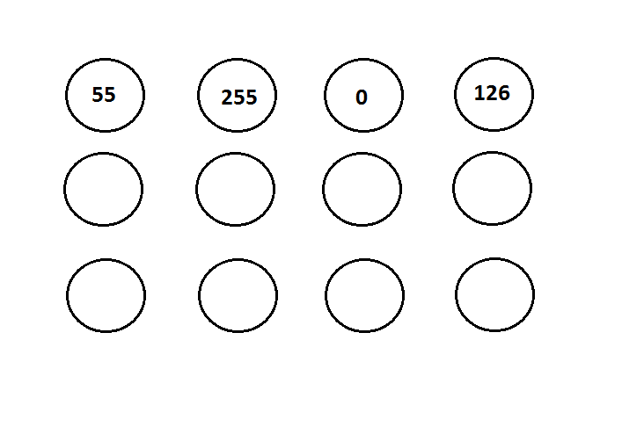
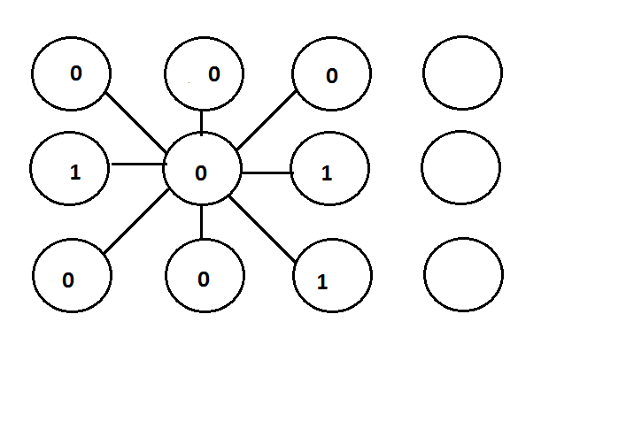
Markov Random Field
Original Image pixels
(Grayscale values: 0 – 255)
Labelled pixels
(Values: {0,1}- notochord and background)

Slide 18
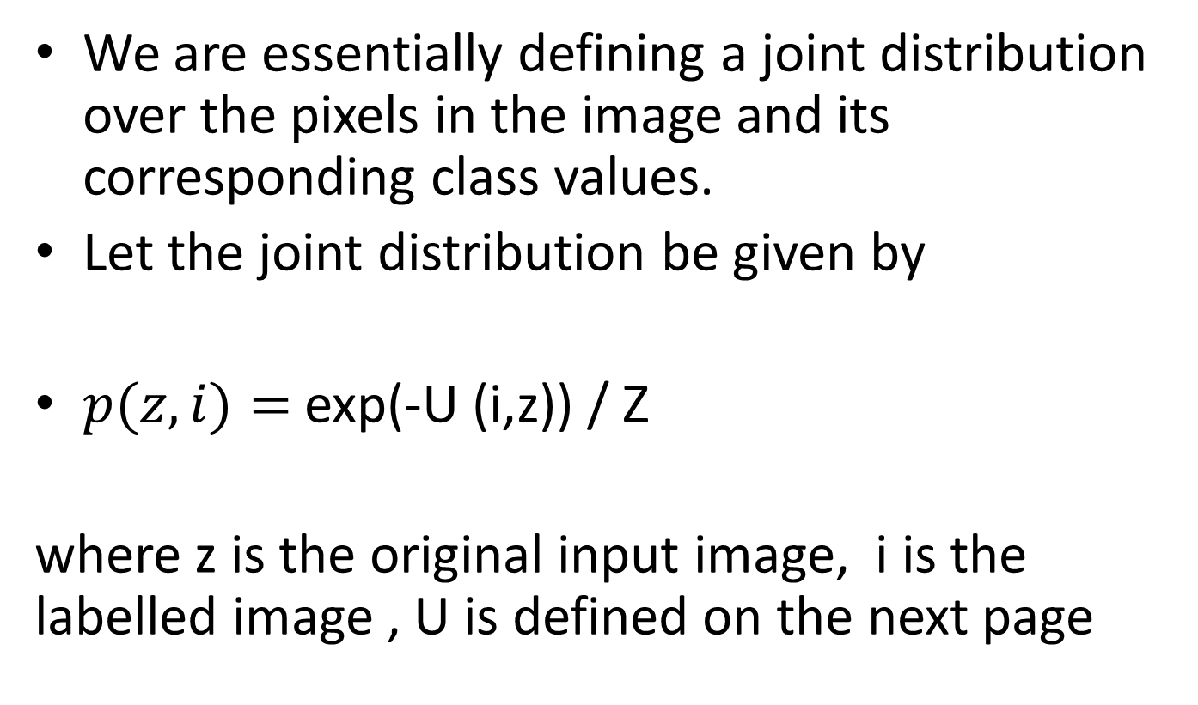
Markov Random Field
We are essentially defining a joint distribution over the pixels in the image and its corresponding class values.
Let the joint distribution be given by
$p(z,i)=$ exp(-U (i,z)) / Z
where z is the original input image, i is the labelled image , U is defined on the next page

Slide 19

The MRF associated with the labelling takes the form:
Here, f is the Gaussian density defined in the previous slides, i(x,y) is the label associated with the observed grayscale pixel value z(x,y), d(.) is the kronecker delta function. N is the 8-connected neighborhood

Slide 20

f is the Gaussian density defined in the previous slides

Slide 21
Explanation
Intuitively, the first GM term encourages the labelling of the image based on the calculated Gaussian mixture model.
The second MRF term tries to impose the fact that the center pixel should have the same class as the surrounding pixels. This helps in eliminating spatial outliers.

Slide 22
Minimization of energy function
We need to find an image i(x,y) having maximum probability, for that we need to minimize the energy function We use a technique called as iterated conditional modes
ICM is an application of co-ordinate wise gradient descent

Slide 23
Iterated Condition Modes algorithm
Randomly initialize all values in i(x,y) (the labeled image) with the labeled image classes L=0,1 .
Then we take one node at a time and evaluate the total energy for the 2 possible states i(x,y)=0 and i(x,y)=1, keeping all other node variables fixed.
We set i(x,y) to whichever state has lower energy.
Repeat the same procedure for another node in the image 5.
Go on repeating above step until we reach a suitable stopping criterion- energy remains almost constant

Slide 24
As a brief review, we have applied 2 techniques until now,
SVM
MRF + GM

Slide 25
Combining Classifiers
SVM’s earlier gave good results, but there was a flaw in the code
We thought of combining SVM and MRF so that some of the spatial outliers would be reduced during classification

Slide 26
SVM + MRF
In this classifier, we first classify the image using SVM and get a labelled image z(x,y)
We calculate the number of correct detections of the notochord tissue : True positive(TP), False Positive(FP), TN(True negative) , FN(false negative) rates
We define a posterior probability based on the SVM classifier.

Slide 27
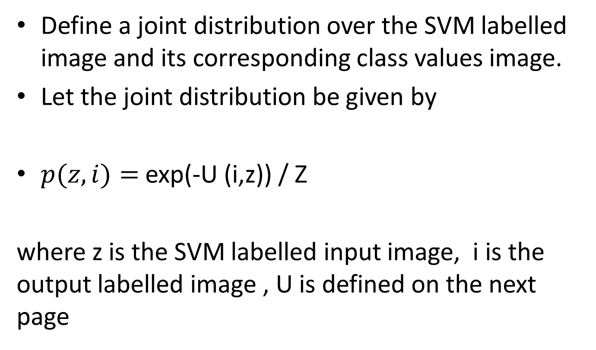
Markov Random Field
Define a joint distribution over the SVM labelled image and its corresponding class values image.
Let the joint distribution be given by
$p(z,i)=$ exp(-U (i,z)) / Z
where z is the SVM labelled input image, i is the output labelled image , U is defined on the next page

Slide 28
The MRF associated with the labelling takes the form:
Here, f is the SVM classified image probability distribution, i(x,y) is the label associated with the observed SVM label value z(x,y), d(.) is the kronecker delta function. N is the 8-connected neighborhood

Slide 29
f is defined as follows:
f(‘1’/’1’) = num(TP)/num( ‘1’ ) :
f(‘0’/’0’) = num(TN)/num( ‘0’ )
f(‘1’/’0’) = num(FN)/num( ‘0’ )
f(‘0’/’1’) = num(FP)/num( ‘1’ )
All these numbers are based on the SVM classification
There are 2 classes:
‘1’ – foreground
‘0’ - background
The minimization of the energy function is performed using ICM

Slide 30
SVM + MRF+GM
In this classifier, we first classify the image using SVM and get a labelled image z(x,y)
We calculate the number of correct detections of the notochord tissue : True positive(TP), False Positive(FP), TN(True negative) , FN(false negative) rates
We define a posterior probability based on the SVM classifier.
Take into account the GM

Slide 31
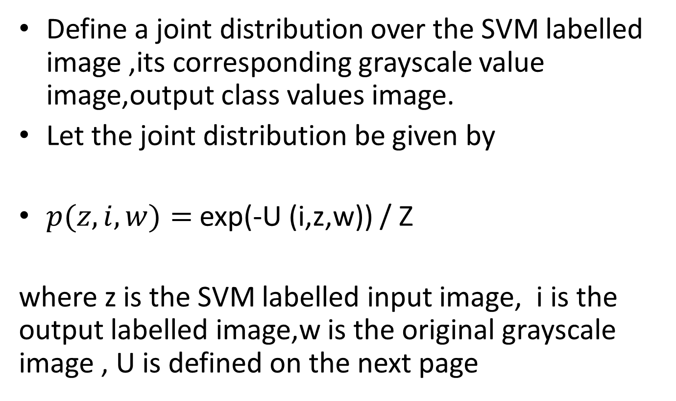
Markov Random Field
Define a joint distribution over the SVM labelled image ,its corresponding grayscale value image,output class values image.
Let the joint distribution be given by
$p(z,i,w)=$ exp(-U (i,z,w)) / Z
where z is the SVM labelled input image, i is the output labelled image,w is the original grayscale image , U is defined on the next page

Slide 32

The MRF associated with the labelling takes the form:
Here, f is the SVM classified image probability distribution, i(x,y) is the label associated with the observed SVM label value z(x,y),w(x,y) is the Gaussian Model

Slide 33
f is defined as follows:
f(‘1’/’1’) = num(TP)/num( ‘1’ ) :
f(‘0’/’0’) = num(TN)/num( ‘0’ )
f(‘1’/’0’) = num(FN)/num( ‘0’ )
f(‘0’/’1’) = num(FP)/num( ‘1’ )
All these numbers are based on the SVM classification
There are 2 classes:
‘1’ – foreground
‘0’ – background
The minimization of the energy function is performed using ICM

Slide 34

f_g
f _g is the Gaussian density defined in the previous section

Slide 35
Unsupervised Image Segmentation
We implement MRF + GM for unsupervised image segmentation.
The initial class labelling is done using the
k-means algorithm.

Slide 36
K-means Algorithm
Given an initial set of means {m1…mk}
Assign each observation to the cluster whose mean yields the least Euclidean distance
Calculate the new means to be the centroids of the observations in the new clusters
Repeat step 1 and 2 until the centroids do not change
This procedure splits the image into ’k’ classes based on their grayscale values.

Slide 37
K-means+MRF+GM
Once we have calculated the clusters, calculate the mean and variance of each cluster and define a GM for each class.
Proceed in the same way as before.

Slide 38
Tools
For the purpose of image classification we have used
Matlab library It contains functions for k-means, SVM.
We have developed the code for MRF and ICM on our own

Slide 39
Overview of Techniques
Supervised Learning
SVM
MRF+GM
MRF+SVM
MRF+GM+SVM
Unsupervised Learning
K-means + MRF +GM
Move onto results:

Slide 40
Notochord Tissue Classification

Slide 41
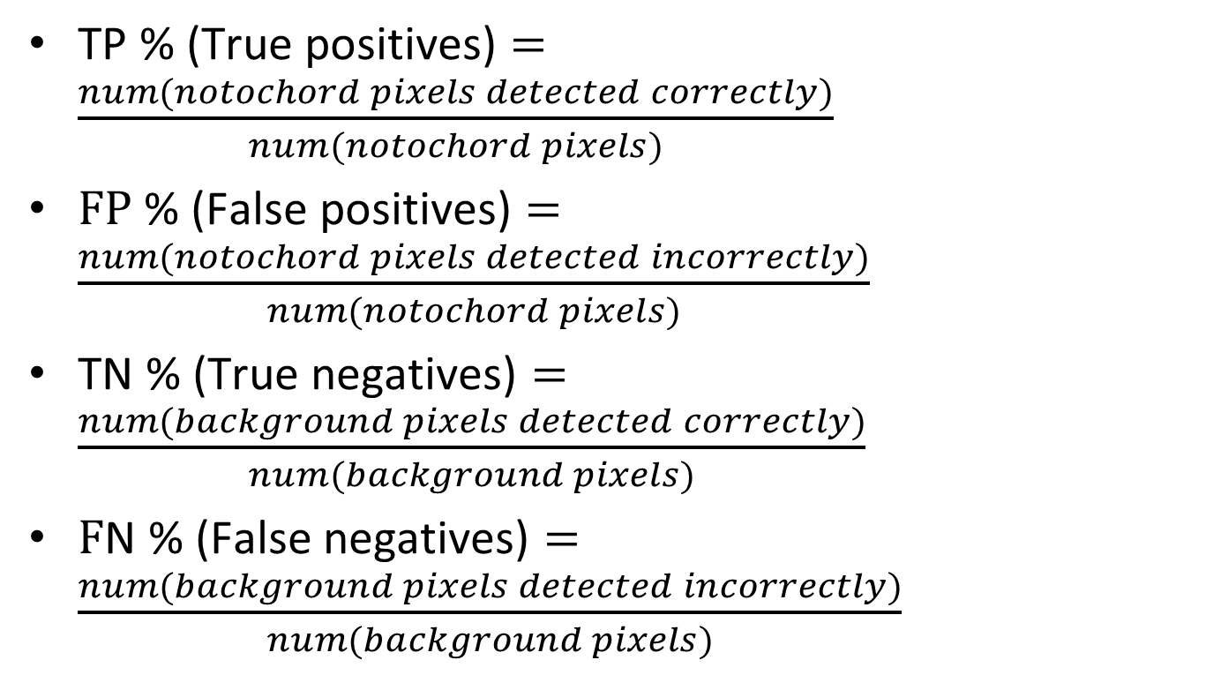
Results Terminology
$\text{TP}\text{ \% (}\text{True} \text{positives}\text{)}=\frac{num(notochord pixels detected correctly)}{num(notochord pixels)}$
$\text{F}\text{P}\text{ \% (}\text{False} \text{positives}\text{)}=\frac{num(notochord pixels detected incorrectly)}{num(notochord pixels)}$
$\text{T}\text{N}\text{ \% (}\text{True} \text{negatives}\text{)}=\frac{num(background pixels detected correctly)}{num(background pixels)}$
$\text{F}\text{N}\text{ \% (}\text{False} \text{negatives}\text{)}=\frac{num(background pixels detected incorrectly)}{num(background pixels)}$

Slide 42

Results Terminology
$\text{Accuracy}\text{ \% }=\frac{num(TP+TN)}{\begin{aligned}num(TP+TN+FP+FN) \\ \end{aligned}}$
The green highlight shows the row with some of the best results.

Slide 43
Results: SVM classification
Classifier | Window Size | C | RBF sigma | TP% | TN% | FP% | FN% | Accuracy%
SVM | 3 | 0.30 | 0.10 | 42.7 | 96.8 | 57.3 | 3.2 | 84.0
SVM | 11 | 0 | 0.10 | 0.1 | 99.8 | 99.9 | 0.2 | 76.1
SVM | 19 | 0 | 10.00 | 89.8 | 95.0 | 10.2 | 5.0 | 93.8
SVM | 27 | 0 | 10.00 | 93.7 | 94.2 | 6.3 | 5.8 | 94.1
SVM | 35 | 0. | 10.00 | 92.6 | 93.5 | 7.4 | 6.5 | 93.3

Slide 44
Results: GM+MRF classification
Classifier | Mu(MRF Bonding variable) | TP% | TN% | FP% | FN% | Accuracy%
GM + MRF | -2.0 | 8.0 | 64.6 | 92.0 | 35.4 | 64.35
GM + MRF | -1.0 | 36.9 | 69.5 | 63.1 | 30.5 | 69.37
GM + MRF | 0 | 93.1 | 50.5 | 6.9 | 49.5 | 50.72
GM + MRF | 1.0 | 86.5 | 53.9 | 13.5 | 46.1 | 54.0
GM + MRF | 2 | 94.9 | 51.9 | 5.1 | 48.1 | 52.08

Slide 45
Results: SVM+MRF classification
Classifier | Window Size | C | RBF sigma | Mu | TP% | TN% | FP% | FN% | Acc%
SVM+ MRF | 19 | 0 | 10 | 0.5 | 95.8 | 95.4 | 4.2 | 4.6 | 95.41
SVM+ MRF | 19 | 0 | 10 | 1.5 | 96.0 | 95.5 | 4.0 | 4.5 | 95.48
SVM+ MRF | 19 | 0 | 10 | 2.5 | 66.8 | 97.5 | 33.2 | 2.5 | 97.41
SVM+ MRF | 27 | 0 | 10 | 1.5 | 99.2 | 98.0 | 0.8 | 2.0 | 97.99
SVM+ MRF | 27 | 0. | 10 | 3 | 69.7 | 99.0 | 30.3 | 1.0 | 98.63
Mu is the MRF bonding variable

Slide 46
Results: SVM+MRF+GM classification
Classifier | Window Size | Cost, RBF sigma | Mu | Mu1 | TP% | TN% | FP% | FN% | Acc%
SVM+ MRF,GM | 19 | 0,10 | -4 | -10 | 80.2 | 95.9 | 19.8 | 4.1 | 95.75
SVM+ MRF,GM | 19 | 0,10 | -2 | -8 | 84.5 | 95.8 | 15.5 | 4.2 | 95.72
SVM+ MRF,GM | 19 | 0,10 | 2 | 4 | 99.8 | 90.1 | 0.2 | 9.9 | 90.18
Mu : MRF bonding variable
Mu1 : GM bonding variable

Slide 47
Results: Comparison
Classifier | TP% | TN% | FP% | FN% | Best Accuracy%
GM + MRF | 8.0 | 64.6 | 92.0 | 35.4 | 64.35
SVM | 89.8 | 95.0 | 10.2 | 5.0 | 93.8
SVM + MRF | 96.0 | 95.5 | 4.0 | 4.5 | 95.48
SVM + MRF+ GM | 84.5 | 95.8 | 15.5 | 4.2 | 95.72

Slide 48
Observations
Although the results seem very promising, more work need to be done
Eliminate false negatives
Post processing required - Analyze the classified images

Slide 49
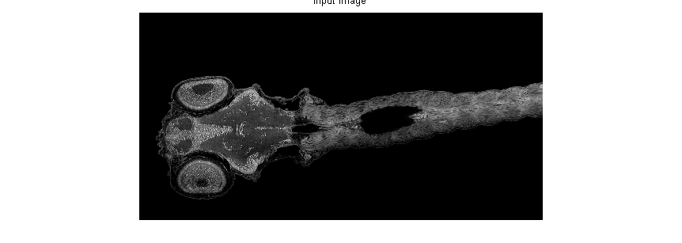
Results : Unsupervised Image Segmentation
Input image:

Slide 50
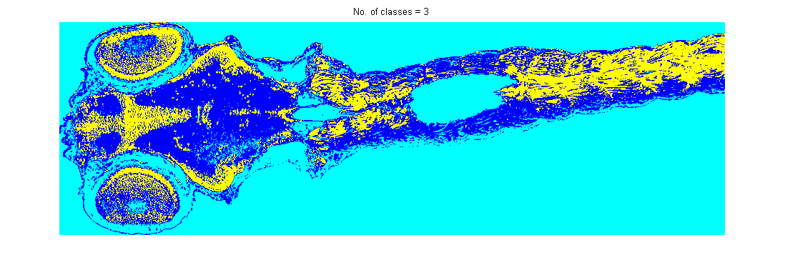
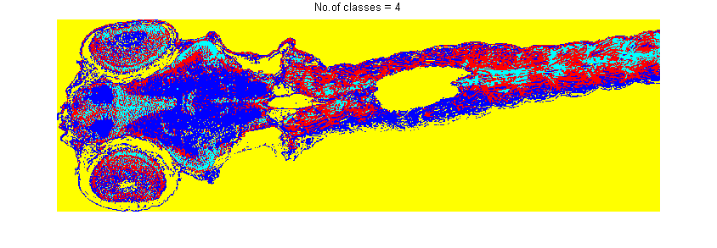
K=3,4

Slide 51
Observations
The unsupervised segmentation does a pretty good job of separating the spinal cord nuclei
With better features, classification might become more meaningful

Slide 52
Conclusions.
SVM’s are very useful because of the different kernels which can be used to map data to a higher dimension
MRF’s are very useful in image segmentation as they take into account the spatial connectivity of pixels
A combination of SVM and MRF improves classification results over both individual methods

Slide 53
Conclusions.
The combination of SVM+MRF+GM gives promising results but requires more fine tuning of parameters
Overall , by using a combination of the methods we achieve an overall improvement of about 3-4% accuracy from the individual methods.
Unsupervised image segmentation can prove useful if combined with better feature vectors, positional information

Slide 54
Future Work
Experimenting with different feature extraction techniques such as histogram of gradients.
Implementing MRF’s in a 3-D environment
Calculating statistics of the tissues: number of nuclei in the tissue, volume of the tissue

Slide 55
Changes made in report
Added new results
Corrected grammatical errors as directed.

Slide 56
List of references
Miller, D. J. and Q. Zhao (2003) “A sequence-based extension of mean-field annealing using the forward/backward algorithm: application to image segmentation,” Signal Processing, IEEE Transactions on, 51(10), pp. 2692–2705.
Jain, A. K. (1989) Fundamentals of digital image processing, Prentice-Hall, Inc
Bishop, C. M. (2006) Pattern recognition and machine learning, springer.

Slide 57
List of references
Duda, R. O., P. E. Hart, and D. G. Stork (2012) Pattern classification, John Wiley & Sons
Blake, A., P. Kohli, and C. Rother (2011) Markov random fields for vision and image processing, Mit Press.

Slide 58
Thank You

